Slide 1
Loading Online Promotions into PEP

Slide 2
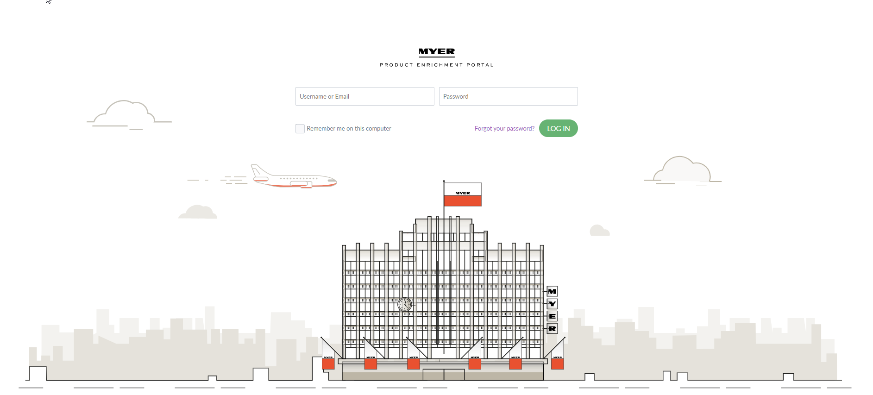
What is this pack about?
We will be learning how to load online promotions into PEP
It is a requirement that all suppliers must submit their own online promotional activity into PEP
We will be covering:
All types of offers you can load online
Loading and amending online promotions
Loading deadlines
PEP or the Product Enrichment Portal is where suppliers submit images, copy and attributes for their product in order for the product to be available on Myer.com.au.
NAME OF PRESENTATION

Slide 3
Types of promotions that can be supported online.
Percentage (%) off
Example: 20% off dresses.
Dollar ($) off
Example: $50 off pants.
Buy 2 or More and Save %
Example: Buy 2 or more pants and save 20% off the order.
Buy 2 or more and save $
Example: Buy 2 or more pants and save $100 off the order.
Spend $ amount or more and save % off
Example: Spend $100 on menswear and save 20% off the order.
Spend $ amount or more and save $ off
Example: Spend $100 on menswear and save $50 off the order.
Buy X and Y for $
Example: Buy pants and jacket together for $250
Buy 3 for $
Example: Buy 3 pants for $250
NAME OF PRESENTATION
NAME OF SECTION

Slide 4
Types of promotions that cannot be supported online
Buy 1 get one free (BOGO)
Example: 2nd item free when you buy 1 item.
Buy 2 get one free
Example: 3rd item free when you buy 2 items.
Buy X and get 2 Y (or more) free
Example: Buy a jacket and receive two pants for free.
Buy X & 2Y (or more) for $
Example: Buy a jacket and receive two pants for $100 each
NAME OF PRESENTATION
NAME OF SECTION

Slide 5
Extracting the Supplier Promotion Export

Slide 6
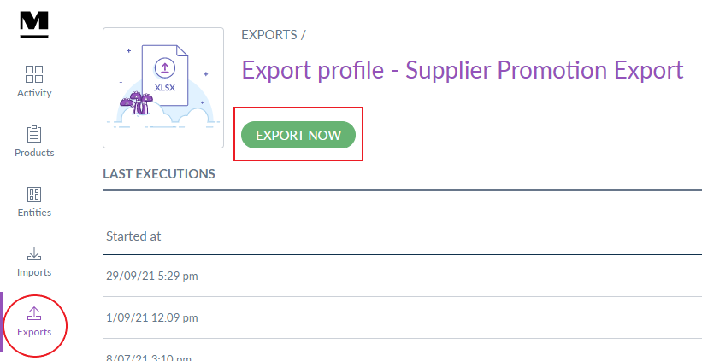
Exporting the file
Go to ‘Exports’ from the left-hand side toolbar
Search for the Supplier Promotion Export and select that export profile
Select Export Now
The Supplier Promotion Export will now start to run
NAME OF PRESENTATION
NAME OF SECTION

Slide 7
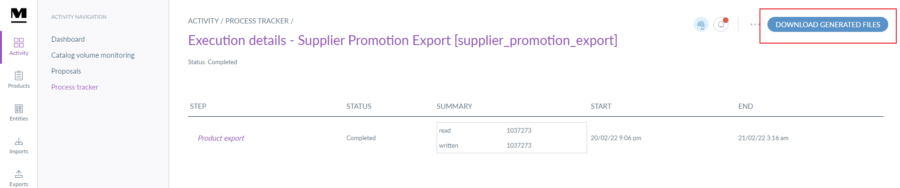
Downloading the file
When the Supplier Promotion Export has finished being exported, you can download the excel document:
PEP will send an email with a link to download the file.
Click on the link and select DOWNLOAD GENERATED FILES from the top right of the page.
NAME OF PRESENTATION
NAME OF SECTION

Slide 8
Loading a Simple Promotion

Slide 9
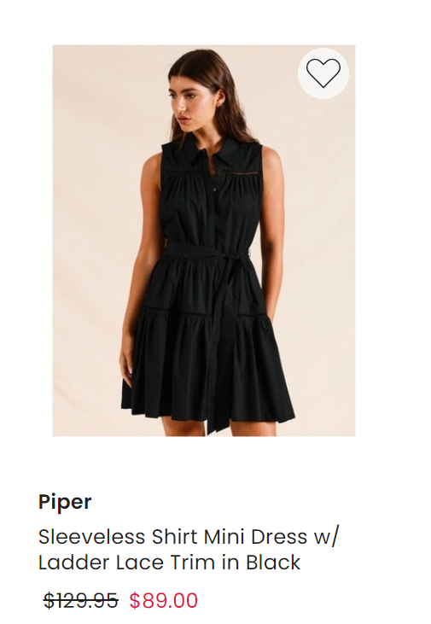
Simple Promotion
Refers to any promotion that involves a straight percentage or dollar amount off. Typically displayed with just a strikethrough statement
Examples:
Display:
20% off
$50 off jeans
Was/now
NAME OF PRESENTATION
NAME OF SECTION

Slide 10
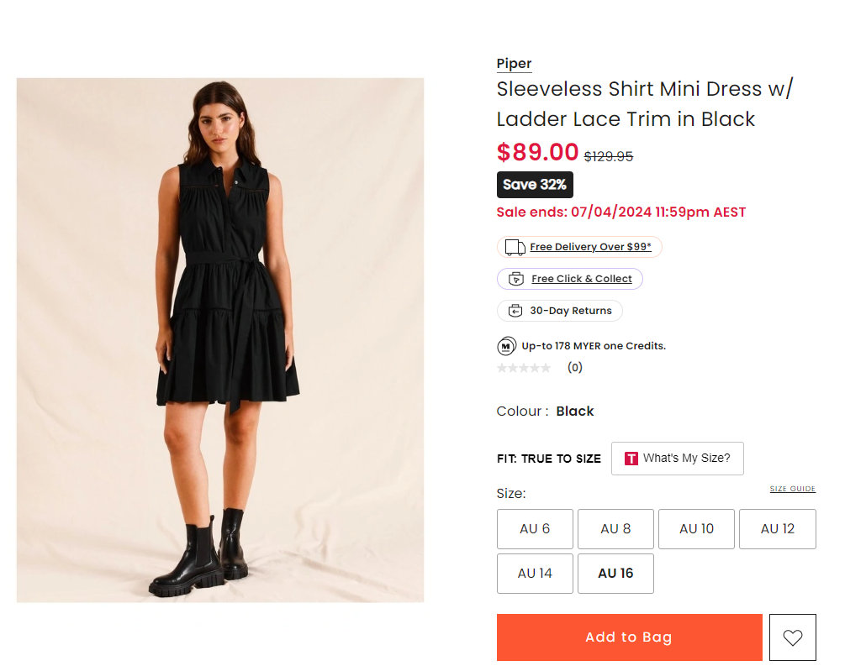
EXAMPLE OF HOW PRICING WILL BE DISPLAYED:
PLP to PDP
NAME OF PRESENTATION
NAME OF SECTION

Slide 11

Applying a simple promotion
To apply a simple promotion, you must load into the ‘promotion columns’ and import the file into PEP 48 hours prior to go live (5 days prior for major events such as ‘Mid-Season Sale’). Simple promotions need their promotional price outlined for it to appear accurately online, otherwise it will appear as a full price item.
End date time is 11:59pm
Short description of what the offer is
Fill in the promotional price
Start date time is 12am
Refer to pg. 13 of the guidelines for all sale type codes
ALL products will be on the export, so please REMOVE the products that are not on promotion.
!
NAME OF PRESENTATION
NAME OF SECTION

Slide 12
Submitting additional simple promotions
Load up to 4 simple offers at a time for a future date.
Promo 1 columns
Promo 2 columns
Online will always display the best price if there are 2 offers applied
Please use the next promotion column If there is an offer that will occur within the same timeframe of an existing promotion or has not yet ended.
!
NAME OF PRESENTATION
NAME OF SECTION

Slide 13
Sale Type Codes
Sale type codes apply filters to an offer, in which the trade team can use to create curated links for homepage, sale page tiles and EDM’s. By applying a sale type code, this will also help increase visibility of an offer by getting picked up in other relevant sales event links. If the filter does not apply to your offer, then you can either use the Hot Price filter or round down to the nearest relevant filter (e.g. if your product is discounted at 37% off then the 35% off filter can be used).
Simple Promo & MYER ONE Sale Type Codes
Complex Promo Sale Type Code
Offer type | Code
5% off | 5_off
10% off | 10_off
15% off | 15_off
20% off | 20_off
25% off | 25_off
30% off | 30_off
35% off | 35_off
40% off | 40_off
50% off | 50_off
55% off | 55_off
60% off | 60_off
70% off | 70_off
75% off | 75_off
80% off | 80_off
Daily Deal | daily_deal
Hot Price | hot_price
Offer type | Code
Buy More & Save | buy_more_save
Spend & Save | spend_save
TAF | take_a_further
Sale type codes are case sensitive so please ensure the exact format is used when filling out the sale type column
!
NAME OF PRESENTATION
NAME OF SECTION

Slide 14
Loading a Complex Promotion

Slide 15
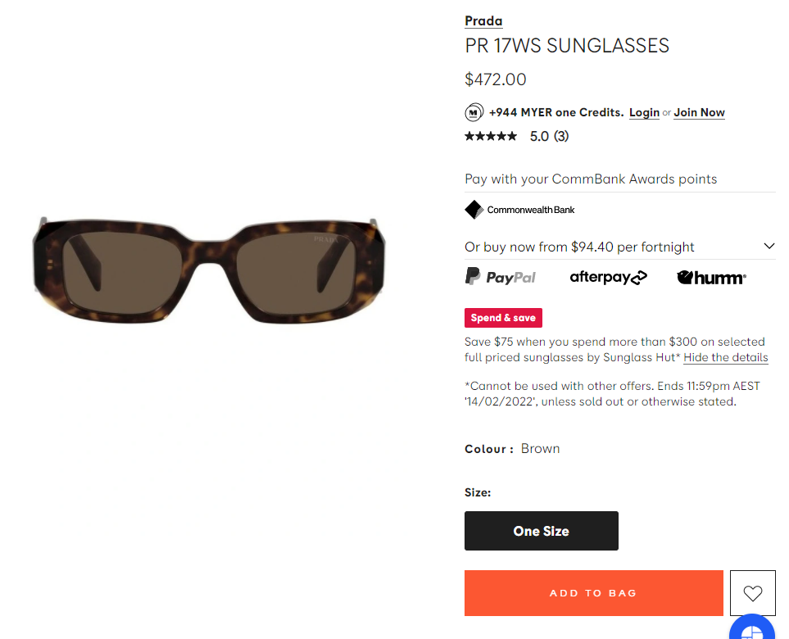
Complex Promotions
Refers to any promotion that requires customers to meet certain conditions in order to receive the discount at checkout.
Examples:
Display:
Take a further
Buy more & save
Spend & save
Multi-buys
Red label
Offer description
NAME OF PRESENTATION
NAME OF SECTION

Slide 16
Applying a complex promotion
Complex promotions do not need their promotional prices outlined as the discount will apply at checkout for the customer. These types of offers must be submitted into the ‘complex promotion columns’, so please refrain from using the ‘promotion columns’. The file needs to be imported into PEP before 2 business days prior to go live (5 business days prior for major events such as ‘Mid Season Sale’).
Start date time is 12am
Refer to pg. 13 of the guidelines for all sale type codes
Be clear in your description, as this will also be displayed on the PDP for the customer.
Be clear in your description, as this will also be displayed on the PDP for the customer.
!
End date time is 11:59pm
NAME OF PRESENTATION
NAME OF SECTION

Slide 17
Submitting additional complex promotions
Load up to 2 complex offers at a time for a future date
Complex Promo 1 column
Complex Promo 2 column
Please use the next promotion column If there is an offer that will occur within the timeframe of an existing promotion or has not yet ended.
!
NAME OF PRESENTATION
NAME OF SECTION

Slide 18
Loading MYER ONE Exclusive Offers

Slide 19
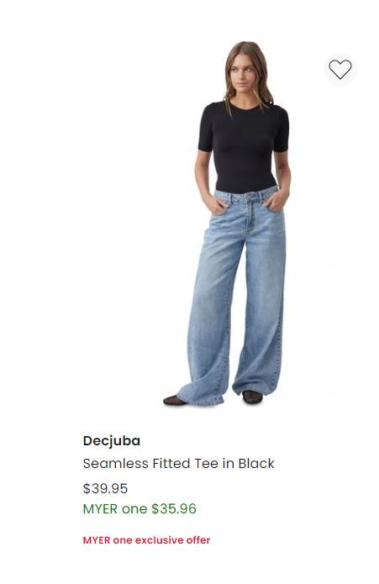
MYER ONE Exclusive Offers
Myer One promotions are offers that are run only for Myer One customers, this is typically displayed with green pricing in both PLP and PDP and a red label.
Examples:
Display:
20% off
$50 off jeans
Green Pricing below RRP
NAME OF PRESENTATION
NAME OF SECTION

Slide 20
MYER ONE Exclusive Offers
To apply a MYER one promotion, you must load into the ‘Myer one promotion columns’ and import the file into PEP 48 hours prior to go live (5 days prior for major events such as ‘Mid-Season Sale’). Myer one promotions need their promotional price outlined in order for it to appear accurately online, otherwise it will appear as a full price item.
Short description of what the offer is
End date time is 11:59pm
Fill in the promotional price
Refer to pg. 13 of the guidelines for all sale type codes
If a simple promotion and a Myer one promotion is running at the same time, the better offer will be displayed on the website.
Start date time is 12am
!
NAME OF PRESENTATION
NAME OF SECTION

Slide 21
Submitting additional MYER ONE promotions
Load up to 4 simple offers at a time for a future date.
Myer One promotional 1 columns
Myer One promotional 2 columns
Online will always display the best price if there are 2 offers applied
Please use the next promotion column If there is an offer that will occur within the same timeframe of an existing promotion or has not yet ended.
!
NAME OF PRESENTATION
NAME OF SECTION

Slide 22
Amending Promotions

Slide 23
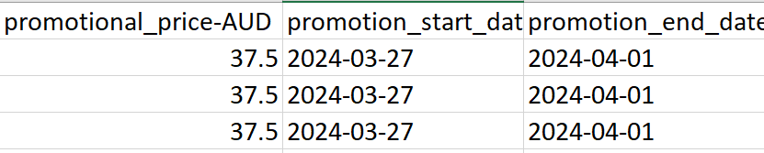
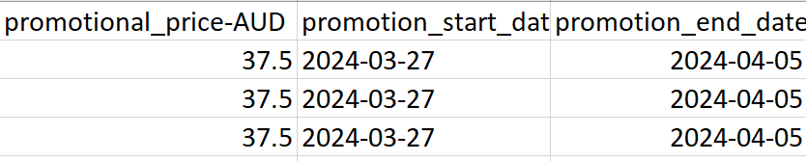
Amending promotional dates, price or offer
To amend any promotional dates, pricing or offer details, update the relevant columns with the new information. We recommend doing a fresh export to ensure you capture everything that needs to be updated. Once done, import it back into PEP and the changes should flow through in 24-48 hours.
For urgent changes, please notify the online promotions team before the start date if you would like to cancel the promotion or if there are any errors with the offer.
Example: Extending the promotion to now end on 5/04
Update the end date column to 5/04
NAME OF PRESENTATION
NAME OF SECTION

Slide 24
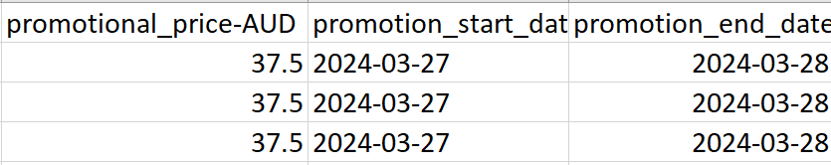
Reverting promotional pricing or offer
To revert the pricing or offer from online, update the end date for the promotion to end today. PEP requires you to manually revert the pricing from the file otherwise it will continue running for the original submitted date. You cannot clear the pricing or delete the item from the file and import it back into PEP, this does not stop the pricing and it will continue for the date it was originally loaded for. Once done, import it back into PEP and the changes will reflect in 24 - 48 hours.
Example: Removing $37.50 price from item
!
Do not clear the pricing or delete the item from the file and import it back into PEP. Otherwise, it will continue for the date it was originally loaded for.
Update the end date column to today's date for pricing to end on the item
NAME OF PRESENTATION
NAME OF SECTION

Slide 25
CLEARANCE OR MARKDOWN PRICING

Slide 26
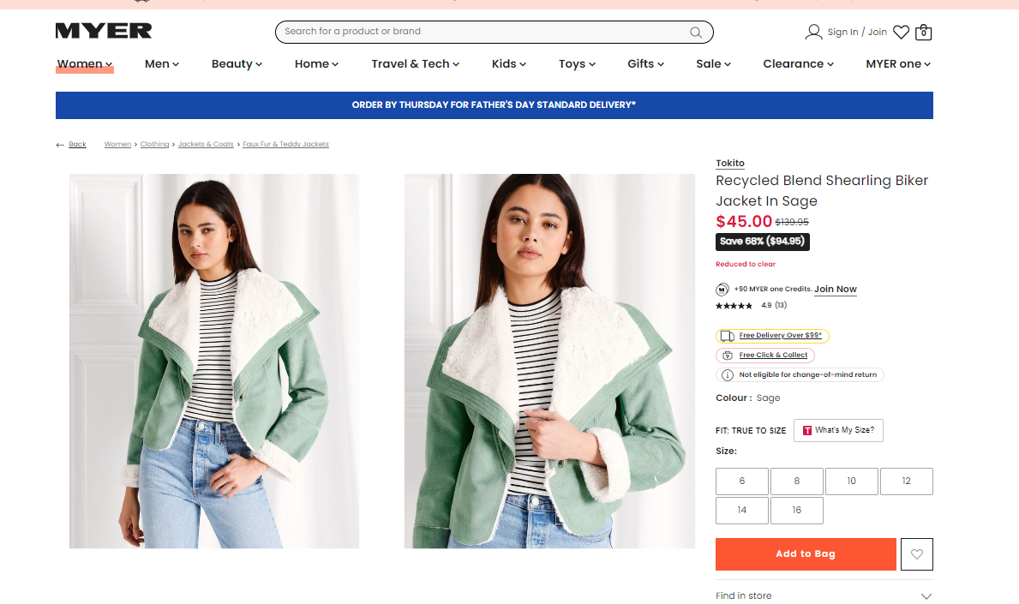
Option 1. Clearance
MUST be loaded as Clearance in Retek to appear on myer.com
No action required in PEP
Once loaded into RETEK, it will flow through to the website in 48 hours.
Items marked as unable to be returned and ‘Reduced to clear’ label visible to customers
Marketplace Suppliers: Please email Dropship Operations team to load clearance. (DSVoperations@myer.com.au)
NAME OF PRESENTATION
NAME OF SECTION

Slide 27
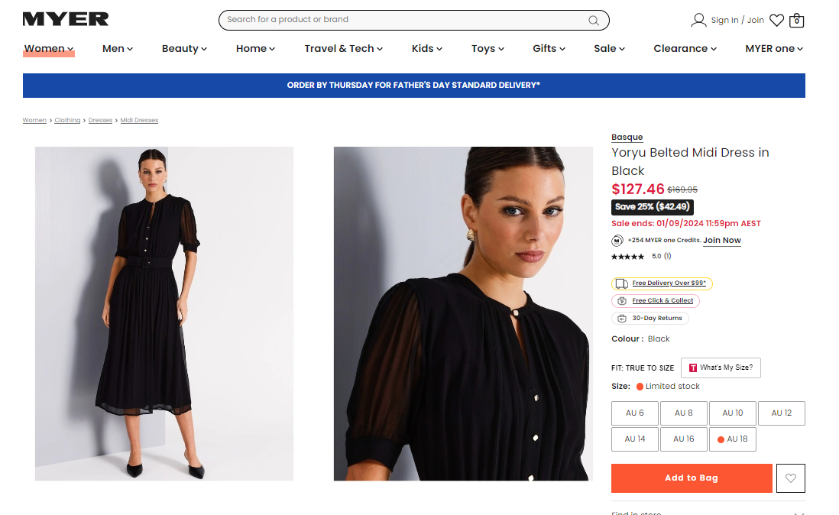
Option 2. Temporary markdown as a promotion
Was/now pricing visible to the customer
End date visible to the customer
Must be loaded as a simple promotion in PEP.
Must have a reasonable end date eg. end of the season.
Must be loaded as a promotion in Retek to scan in stores.
Items are returnable.
NAME OF PRESENTATION
NAME OF SECTION

Slide 28

What else do I need to know?
If you need to amend any pricing, please do a fresh export and update the relevant columns.
Import the file back only with the applicable items and columns that need to be amended
For urgent changes, please notify the online promotions team before the start date if you would like to cancel the promotion.
Clearance markdowns will need to be actioned in RETEK and will flow through automatically flow to the website (along with the strikethrough was price and the reduced to clear label).
NAME OF PRESENTATION
NAME OF SECTION

Slide 29
IMPORTING THE SUPPLIER PROMOTION EXPORT

Slide 30

Loading deadlines
Complete and import the file 48 hours prior to go live (5 days prior for major events such as ‘Mid-Season Sale’).
You can do a fresh export to also check the file has been loaded into PEP successfully.
NAME OF PRESENTATION
NAME OF SECTION

Slide 31
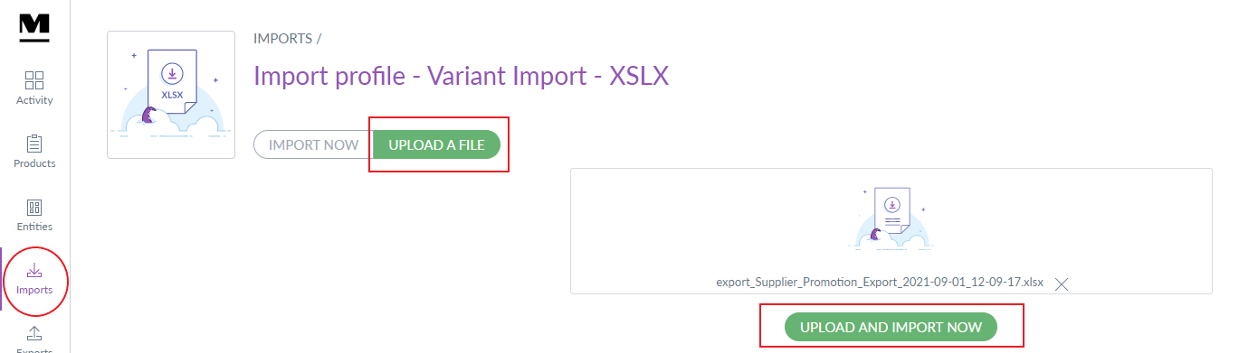
Loading the file into PEP
Once you have completed your file and ready to import into PEP:
Import the file using the Variant Import – XSLX via the Imports tab located on the left-hand side toolbar
Stay on this page whilst the file loads in case there are any errors.
NAME OF PRESENTATION
NAME OF SECTION

Slide 32
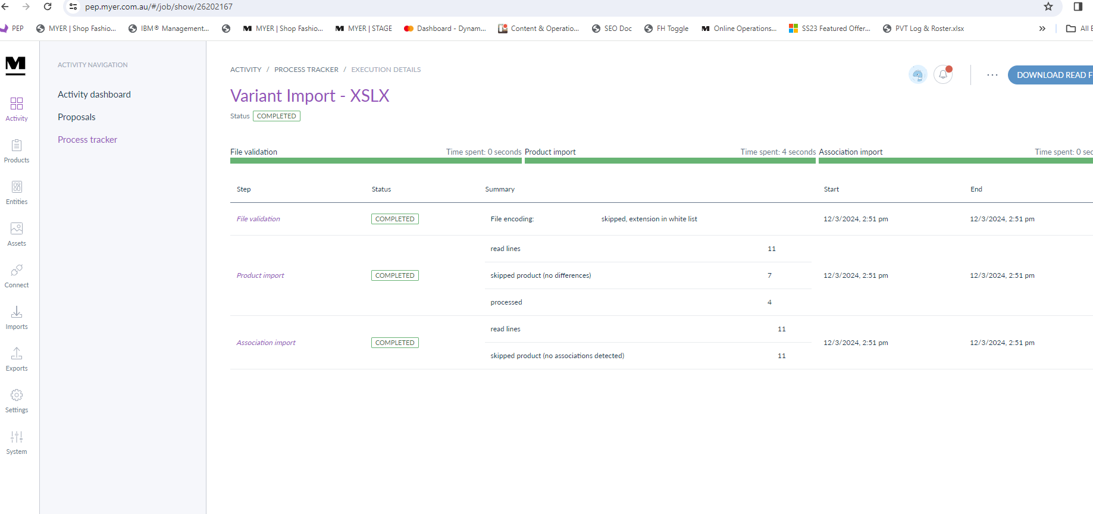
Loading the file into PEP
After importing the file, PEP will let you know if there are an errors and if the file has been loaded successfully. If there are any errors, please email onlinepromotions@myer.com.au and we will advise you how you resolve the issues.

